Slide 1
Good Morning
Take your name tag
Check-in

Slide 2




Data Analysis
Notes:
Today, we will cover
Talk about the progress of the project on Canvas
We have
Mid-semester Peer evaluation
Meeting with instructor
Presentation
Final Project Report
Peer evaluation
We will cover analysis until presentation day. SO if you need help with your analysis, I can help in in the optional project meeting. But besides that, I cannot walk through every group’s analysis

Slide 3


Inference – Statistics and Parameters
What do statistics measure?
What do parameters measure?
Notes:
Just a reminder,
What do statistic measure? Statistics measure the characteristics of a sample
What do parameters measure? Parameters measure the characteristics of a population

Slide 4
Statistics vs. Parameters
Statistics: values that are computed from information provided by a sample (e.g., sample average)
Parameters: values that are computed from a complete census which are considered to be precise and valid measures of the population (e.g., population average)
In other words, Parameters represent “what we wish to know” about a population. Statistics are used to estimate population parameters
Generalizing a Sample’s Findings to Its Population
Population
Sample
Notes:
This slide gives you a reminder on the definition of statistics and parameters.
Note: since we are interested in the population parameters (population mean from all the Mizzou students), we cannot use sample statistics directly (sample mean from a sample of Mizzou students),
We need to do some calculations, which will be covered in today’s lecture, to infer the population parameters by factoring in the uncertainty in our sample statistics.

Slide 5
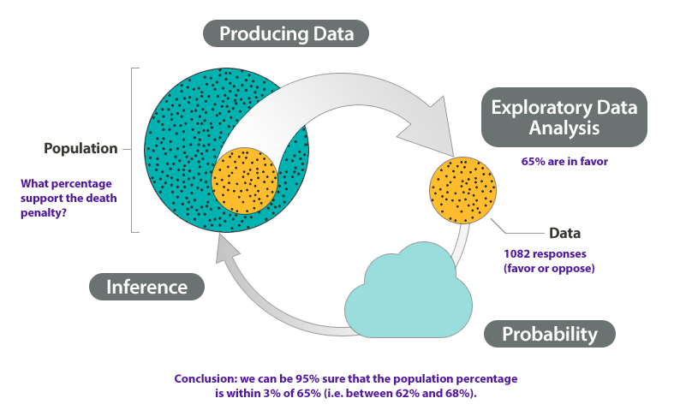
Statistical Inference
A set of procedures in which the sample size and sample statistics (e.g., sample average and sample standard deviation) are used to make estimates of population parameters
Notes:
this is study of statistics. Formally, statistical inference is a set of …
In this preliminary class, we can only cover so much. Hence, we have sample average and standard deviation. There are more sample statistics beyond these two, such as proportion.
Talk about the example

Slide 6
Parameter Estimation
What we know: sample statistics such as mean, mode, standard deviation, range etc.
The sample statistic may be either
Use sample statistics to infer about the population through confidence intervals
So what is confidence intervals?
a percentage, (i.e., 12% of the respondents stated they were “every likely” to patronize a new restaurant OR
a mean, i.e., the average amount spent per month in restaurants is $185
Notes:
We can know sample statistics such as mean, model, standard deviation, or range.
Typically, we cannot know the true range of the population,
However, with sample statistics such percentage or mean, we can infer mean and percentage for population parameters
Can someone quickly remind me when we use percentage and when we use mean?
Categorical: percentage
Continuous: mean
Going from sample statistics to population parameters, we have to quantify our uncertainty. Or in other words, we can quantify our confidence in having the true population parameters
That’s where confidence intervals come in.
Formally, it gives a range of values for an unknown parameter. The interval has an associated confidence level chosen by the investigator. We will talk more about this with its formula.

Slide 7
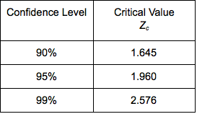
Parameter Estimation
Confidence Interval:
Mean: $\overline{x}±t_{\left\{critical\right\}} ∗SE$
Mean: 𝑥 ̅±𝑡_{𝑐𝑟𝑖𝑡𝑖𝑐𝑎𝑙} ∗𝑆𝐸
Standard error = $\frac{SD}{√n}$
Standard error = 𝑆𝐷/(√𝑛)
Proportion: $p±t_{critical} ∗SE$
Proportion: 𝑝±𝑡_𝑐𝑟𝑖𝑡𝑖𝑐𝑎𝑙 ∗𝑆𝐸
Standard error = $√(p∗q/n)$ where p = 1- q
Standard error = √(𝑝∗𝑞/𝑛) where p = 1- q
This Photo by Unknown Author is licensed under CC BY
Notes:
This is the formula to calculate the confidence interval for mean and proportion.
As mentioned in the last slide, mean is used for continuous variables, while proportion is used for categorial variables
You need to be careful to choose the type of descriptive statistics that you want to report.
After you have your formula, you also have to decide at what level of confidence do you want to calculate
I think most of you have seen this table of translation between confidence and critical value of Z, or t
Because t with large sample resemble z distribution
In this sense, we might use the two interchangeably in some cases. But you should know the difference
We will go into examples in excel. (confidence interval file) and also the excel help sheet
And also in R
https://rstudio.cloud/project/2980145

Slide 8
Example 1
Those who dine out on Wednesday’s, spend on an average $45.2, SD = 20, n = 500, 95% confidence (t = 1.96)
Notes:
Formula:
For percentage, p + t*SE, p – t*SE
For mean, xbar + t*SE, xbar – t*SE
p is the sample percent. xbar is the sample mean.
SE: standard error
For percentage: square root (p*q/n) note: p = 1-q
For mean: SD/square root(n) note: SD is standard deviation
t value @ difference confidence level: @90%: 1.65 @95%: 1.96 @99%: 2.58
Question: a) why do we need confidence interval? why can’t we just use the descriptive statistics - mean or percent?

Slide 9
Answers
Compute Confidence Intervals
Mean = 45.2, SD = 20, n = 500
[45.2 +/- 1.96*20/SQRT(500)]
$43.45 - $46.95
Conclusion:
We are 95% confident that in population the people who dine out on Wednesday spend between $43.45 to $46.95

Slide 10
Example 2
30% people say they dine out on Wednesday’s, n =500, 95% confidence (i.e., t = 1.96)
Notes:
Formula:
For percentage, p + t*SE, p – t*SE
For mean, xbar + t*SE, xbar – t*SE
p is the sample percent. xbar is the sample mean.
SE: standard error
For percentage: square root (p*q/n) note: p = 1-q
For mean:SD/square root(n) note: SD is standard deviation
t value @ difference confidence level: @90%: 1.65 @95%: 1.96 @99%: 2.58
Question: a) why do we need confidence interval? why can’t we just use the descriptive statistics - mean or percent?

Slide 11
Answer
Compute Confidence Intervals
p = 30%,n =1,000, t=1.96
26.0% -34.0%
[30-1.96*SQRT(30*70/500), 30+1.96*SQRT(30*70/500)]
Conclusion:
We are 95% confident that in population, 26% to 34% of people dine out on Wednesday.

Slide 12
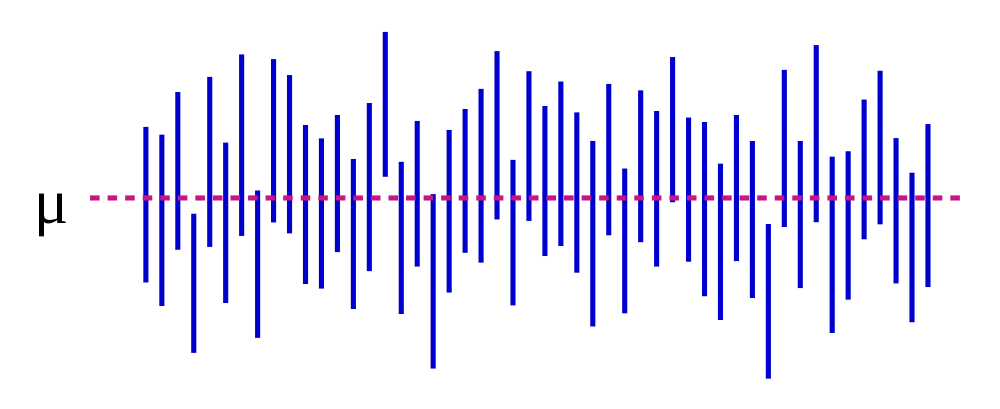
Confidence Interval Visualization
This Photo by Unknown Author is licensed under CC BY-SA
Notes:
Explain this plot
Note: 95% confidence in math means we draw 100 samples, 95% of the sample average will fall within the range.

Slide 13
Parameter Estimation
What does confidence level mean?
It means that we can say that if we did our study over 100 times (although we only did ONCE), we can determine a range within which the sample statistic will fall 95 times out of 100 (95% level of confidence). This gives us confidence that the real population value falls within this range
100 times, ($32, $35) $33.5

Slide 14
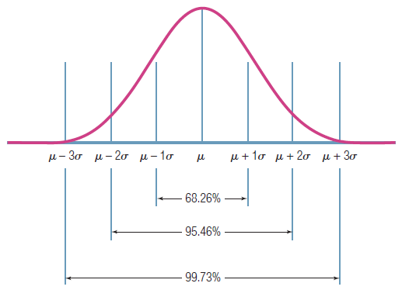
Confidence level visualization – increase the confidence level, the interval will be widened
95% confidence level covers the 95% of sample mean if we keep drawing the samples from the population randomly
Notes:
Sigma here stands for the population average standard deviation – it is calculated by the sample SE = SD/SQRT(n)
mu is the population average. sigma is the population variation.

Slide 15
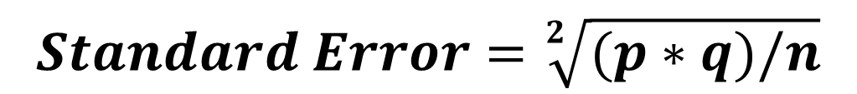

Parameter Estimation
If we have percentage,
If we have mean,
Given the same sample size, the more variability, the __ the standard error.
The lower the standard error, the __ precisely our sample statistic will represent the population parameter
Notes:
Given the same sample size, the more ….
So we here we have seen standard error and standard deviation, can you tell me what the difference between the two?

Slide 16
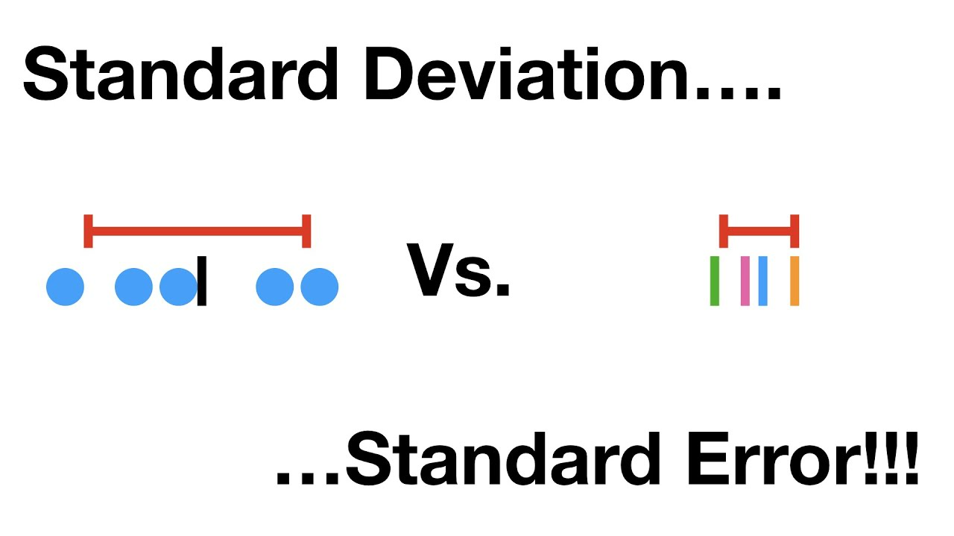
Difference between SE and SD
The standard deviation (SD) measures the amount of variability, or dispersion, from the individual data values to the mean,
The standard error of the mean (SEM) measures how far the sample mean (average) of the data is likely to be from the true population mean.
Notes:
Reminder
Note the SD (standard deviation) and SE (standard error) are different in formula.
The standard deviation (SD) measures the amount of variability, or dispersion, from the individual data values to the mean, while the standard error of the mean (SEM) measures how far the sample mean (average) of the data is likely to be from the true population mean.

Slide 17

Confidence Intervals for Proportions (Categorical Measures)
Confidence Interval
A projection of the range within which a population parameter will lie at a given level of confidence, based on a statistic obtained from a probabilistic sample
This is why you need to draw a probability sample

Slide 18
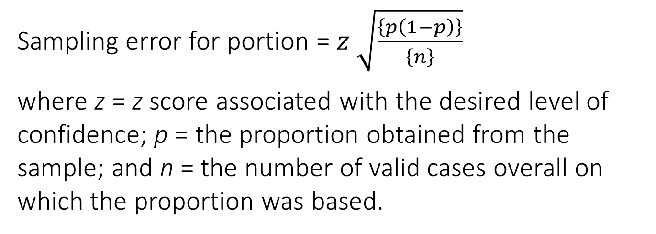
Confidence Intervals for Proportions (Categorical Measures)
Sampling error for portion = $z \sqrt{\frac{\left\{p\left(1−p\right)\right\}}{\left\{n\right\}}}$
where z = z score associated with the desired level of confidence; p = the proportion obtained from the sample; and n = the number of valid cases overall on which the proportion was based.
CONFIDENCE INTERVAL:

Slide 19
Question: What percentage of AFC members are women?
Solution: Compute the 95% confidence interval based on the proportion of respondents in the sample that indicated that they were women.

Slide 20
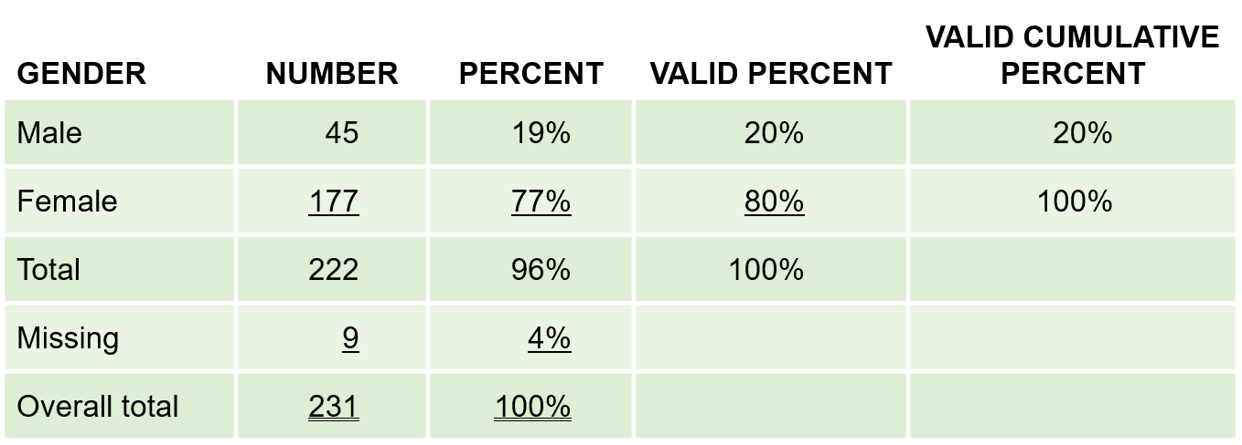
Question: What percentage of AFC members are women?
Based on the sample result, our best guess is that 80% of the population are women…
Exhibit 17.1 Avery Fitness Center: Gender

Slide 21
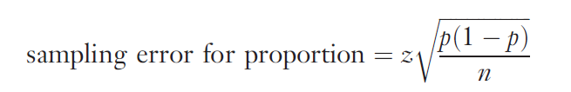
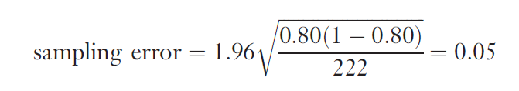
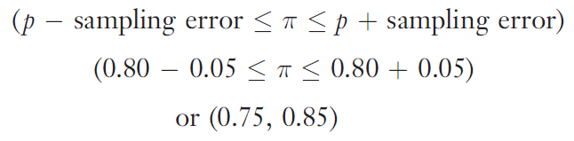
Question: What percentage of AFC members are women?
Therefore, we would be 95% confident that the proportion of women in the AFC population lies between .75 and .85, inclusive.

Slide 22

Caution in Interpreting Confidence Intervals
The confidence interval only takes sampling error into account
It DOES NOT account for other common types of error (e.g., response error, nonresponse error)
The goal is to reduce TOTAL error, not just on type of error.

Slide 23
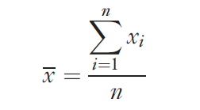
Basic Univariate Statistics
Descriptive Statistics
Statistics that describe the distribution of response on a variable. The most commonly used descriptive statistics are the mean and standard deviation.
Sample Mean: the arithmetic average value of the responses on a variable

Slide 24
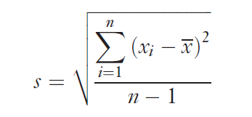
Basic Univariate Statistics
Sample Standard Deviation
A measure of the variation of responses on a variable. The standard deviation is the square root of the calculated variance on a variable.

Slide 25
Why worry about the Sample Standard Deviation?
Case– the New Sauce Product
The mean score on a measure of how hot consumers preferred a new sauce to be suggested that they wanted it moderately hot. Unfortunately, most consumers either wanted it wild or hot, with relatively little demand for a moderate sauce

Slide 26

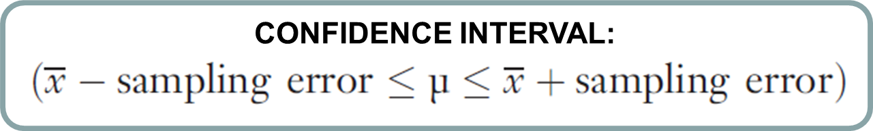
Confidence Intervals for Means (Continuous Measures)
where
z = z score associated with the desired level of confidence
s = the sample standard deviation
n = the total number of cases used to calculate the mean.

Slide 27
Question: How many times per month do AFC members visit the center?
Solution: Compute the 95% confidence interval based on the mean number of visits to the Center reported by sample respondents.
Based on the responses of 198 AFC members, we learn that the mean number of trips was 10.0, with a standard deviation of 7.3

Slide 28
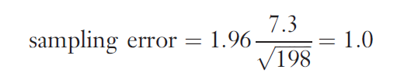
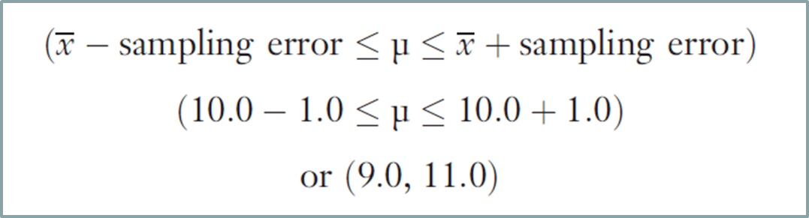
Question: How many times per month do AFC members visit the center?
Therefore, we would be 95% confident that the mean number of trips per month in the AFC population lies between 9 and 11, inclusive.

Slide 29
Data Analysis Plan Template Assignment 6
 |  | Data Analysis Plans
(1) | (2) | (3) | (4) | (5) and (6)
Research Question | Type of Research Question* | Questionnaire Question | Level of Measurement** | Descriptive statistics or Statistical Test
* descriptive or differences research question
** nominal, ordinal, interval, or ratio
Notes:
Go to assignment 6
https://umsystem.instructure.com/courses/41919/assignments/871304?module_item_id=2985137
Show template
And go through example with students

Slide 30
15-min Group Discussion
Sign up for presentation day (same link for the project meeting)
Each team will present 15 mins and 5 mins Q&A
Not all group members need to present (As long as your group finds optimal task allocation).
Discuss questions that allow you to use descriptive statistics (e.g., mean, prop, confidence interval)

Slide 31
Up next
Visualization and Presentation
PA #6: Data Analysis Plan

